Slide 1
Medical Inventory System
Created By-
Mahendra Nain (120CS0956)
SVS Pavan (120CS0958)
Kush Chandresh Bhai(120CS0959)
Mahendra Singh (120CS0960)

Slide 2
Table of Contents
Introduction
SDLC Model
Functional Requirements
Non-Functional Requirements
Use-Case Diagram
Data Flow Diagrams
Activity Diagram
Class Diagram
Sequence Diagrams
User Interface
Code Snippets

Slide 3
Introduction * The medical industry deals with life and death situations every day. Therefore, it is essential to have an efficient and effective inventory management system to ensure that medical supplies and equipment are always available when needed. The purpose of this project report is to describe the development of a medical inventory system software. * Medical Inventory System or Medical Inventory Management System in a software which automates processes such as ordering, receiving, storing, and tracking inventory details. * MIMS is inspired by the just-in-time (JIT) philosophy.

Slide 4
SDLC Model Selection
The SDLC Model/Approach used is Rapid Application Development (RAD) Model.
Requirement Gathering :- In this step, we would gather all the details about the specific requirements by the customer(user) which are needed to develop Medicine Inventory Management System(MIMS). We would identify the required features, such as the ability to add a specific medicine or update the stock and can be able to print cheque and receipt.
Prototyping : Based on the requirements gathered, we would develop a prototype of the MIMS. The prototype would allow the user to do all the tasks which are specified in the requirement gathering phase

Slide 5
SDLC Model contd.
Iterative Development : After providing a prototype to the customer and taking the feedback about the functionalities and the user interface. The MIMS software will be evolved by fixing the bugs that got encountered and by updating as per the requirements of the customer(user).
Rapid Development : Once the development is complete, the MIMS software can be integrated with other systems used by the company and tested thoroughly to ensure that it meets all the requirements and the system is free of bugs and errors.

Slide 6
Functional Requirements
Calculating Threshold
Generating list if items to buy
Updating Inventory
Managing Payments to Vendor
Updating Database with new medicine
Getting stock of medicine
Generating list of expired medicines
Printing cash receipt
Calculating Revenue and Profit for each month
Calculating Vendor wise payment details for each month

Slide 7
Non-Functional Requirements
User Friendly UI
A stable internet connection
At least 2GB of decent RAM space (this prevents cloggy loading of MIMS website on the device)
The device on which the MIMS runs should be able to compile and render some software technologies like React.js
MIMS is so portable that we can run this on any device which has a decent processing power and stable internet connection.

Slide 8
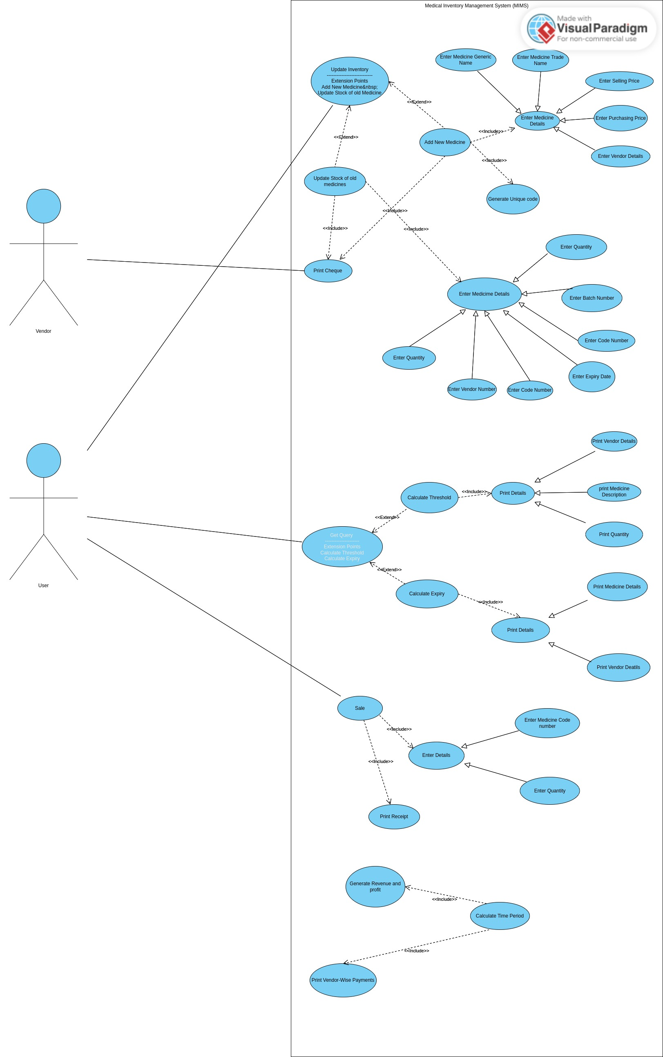
Use Case Diagram

Slide 9
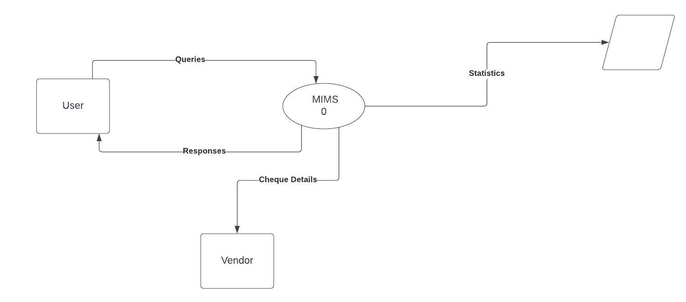
Context Diagram or DFD 0

Slide 10
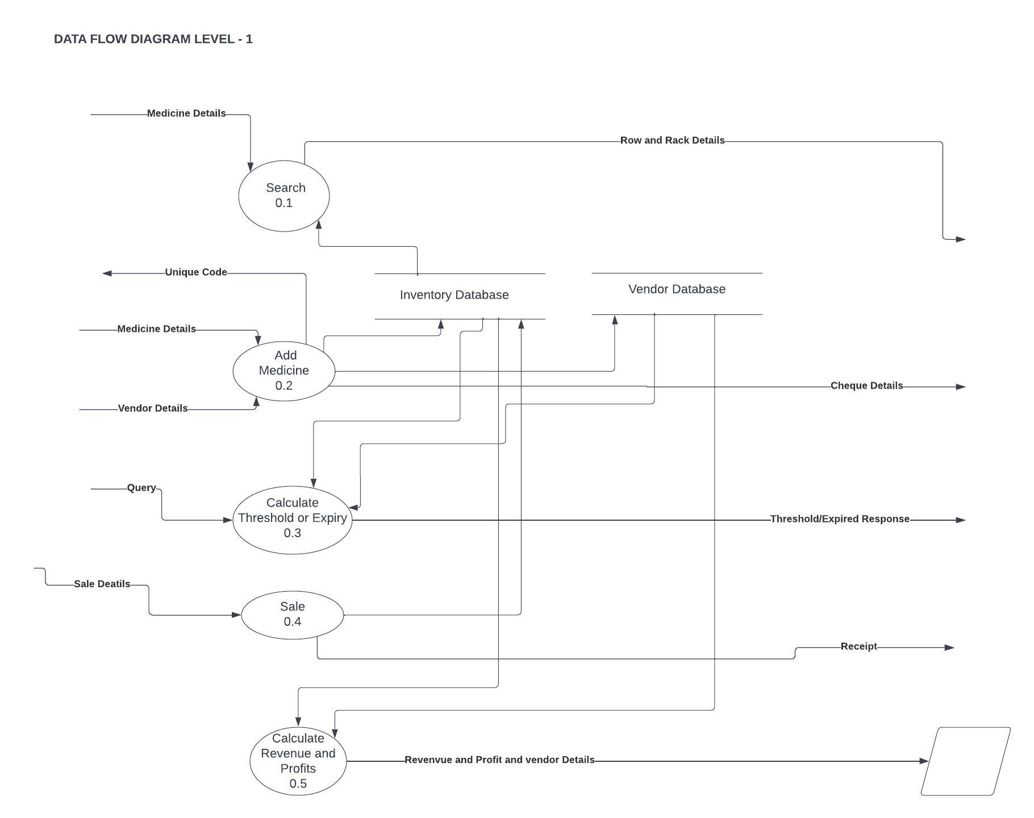
DFD Level - 1

Slide 11
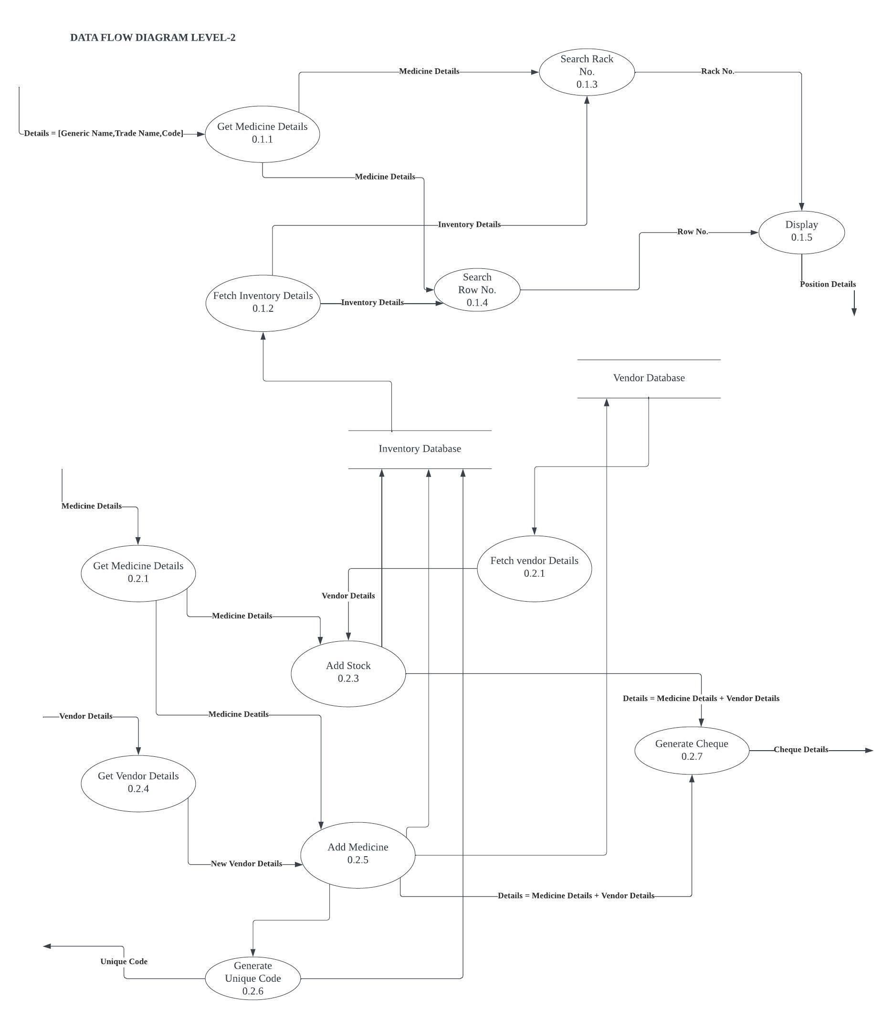
DFD Level – 2

Slide 12
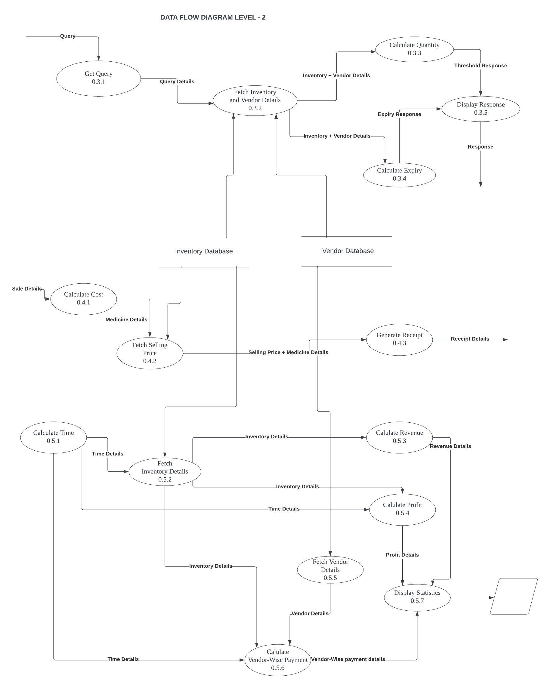
DFD Level – 2

Slide 13
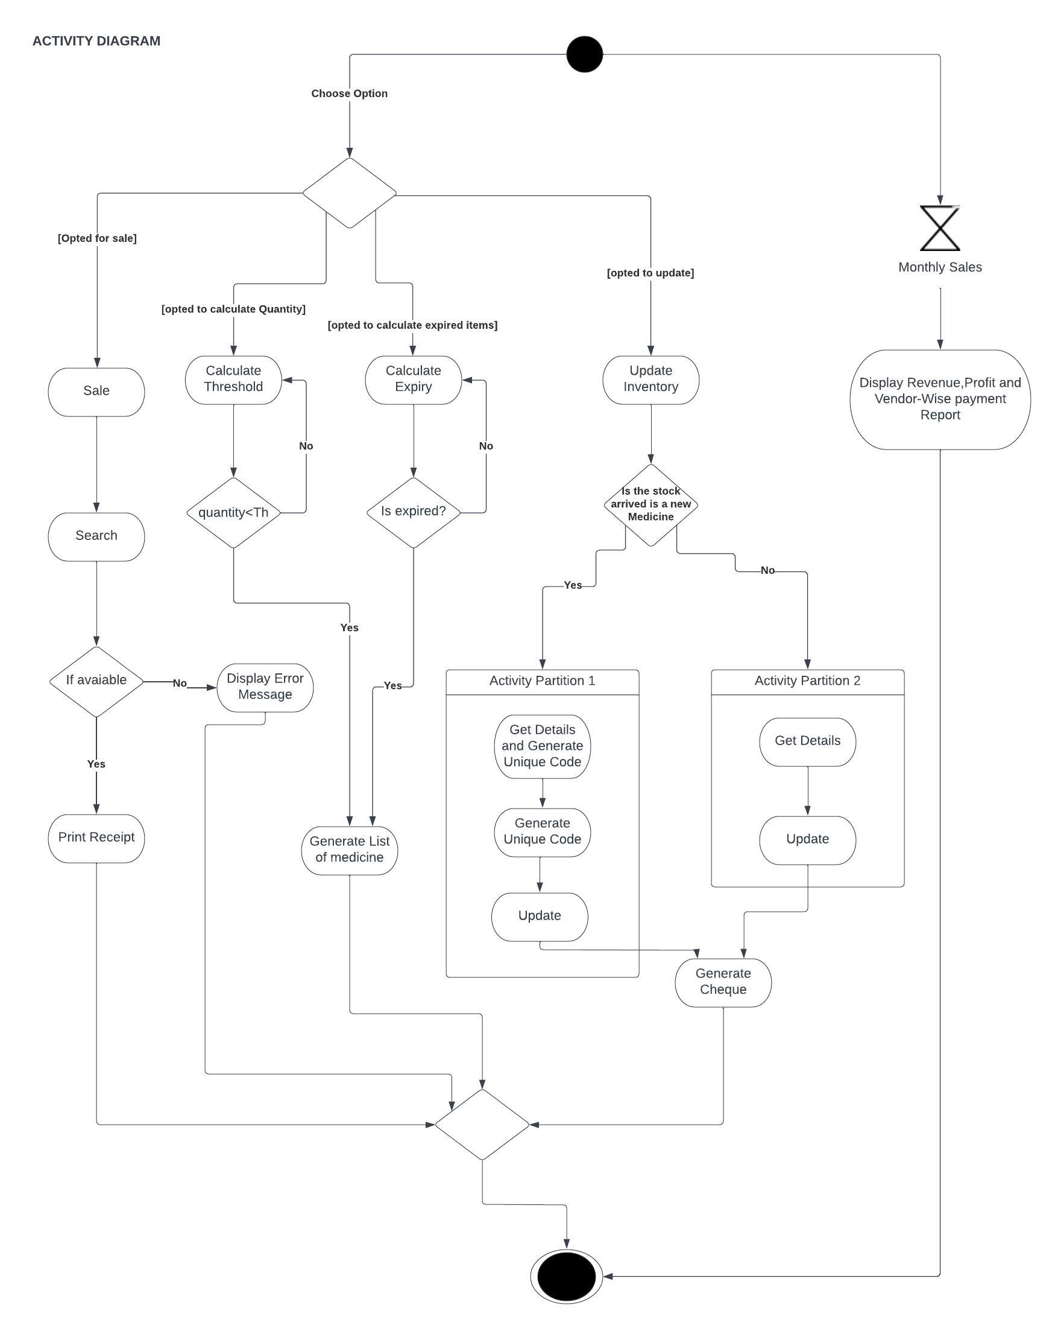
Activity Diagram

Slide 14
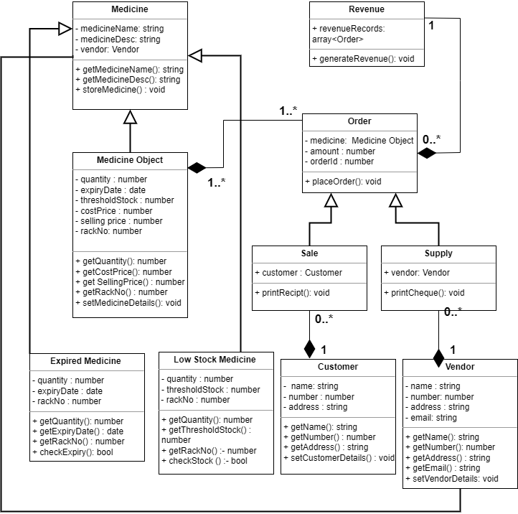
Class Diagram

Slide 15
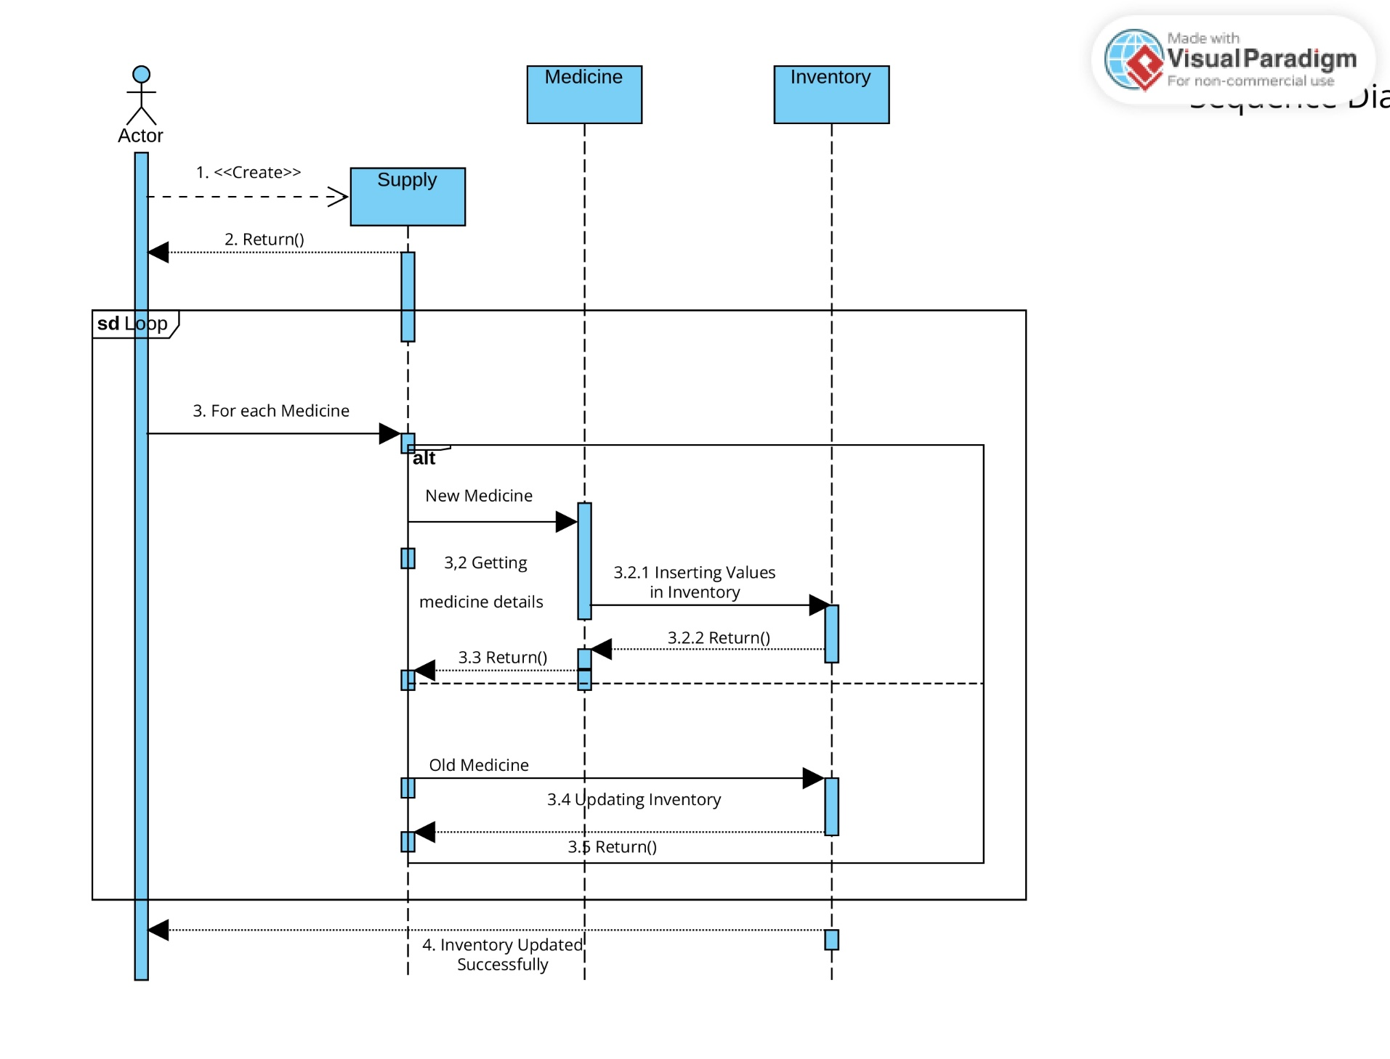
Sequence Diagram for New Supply

Slide 16
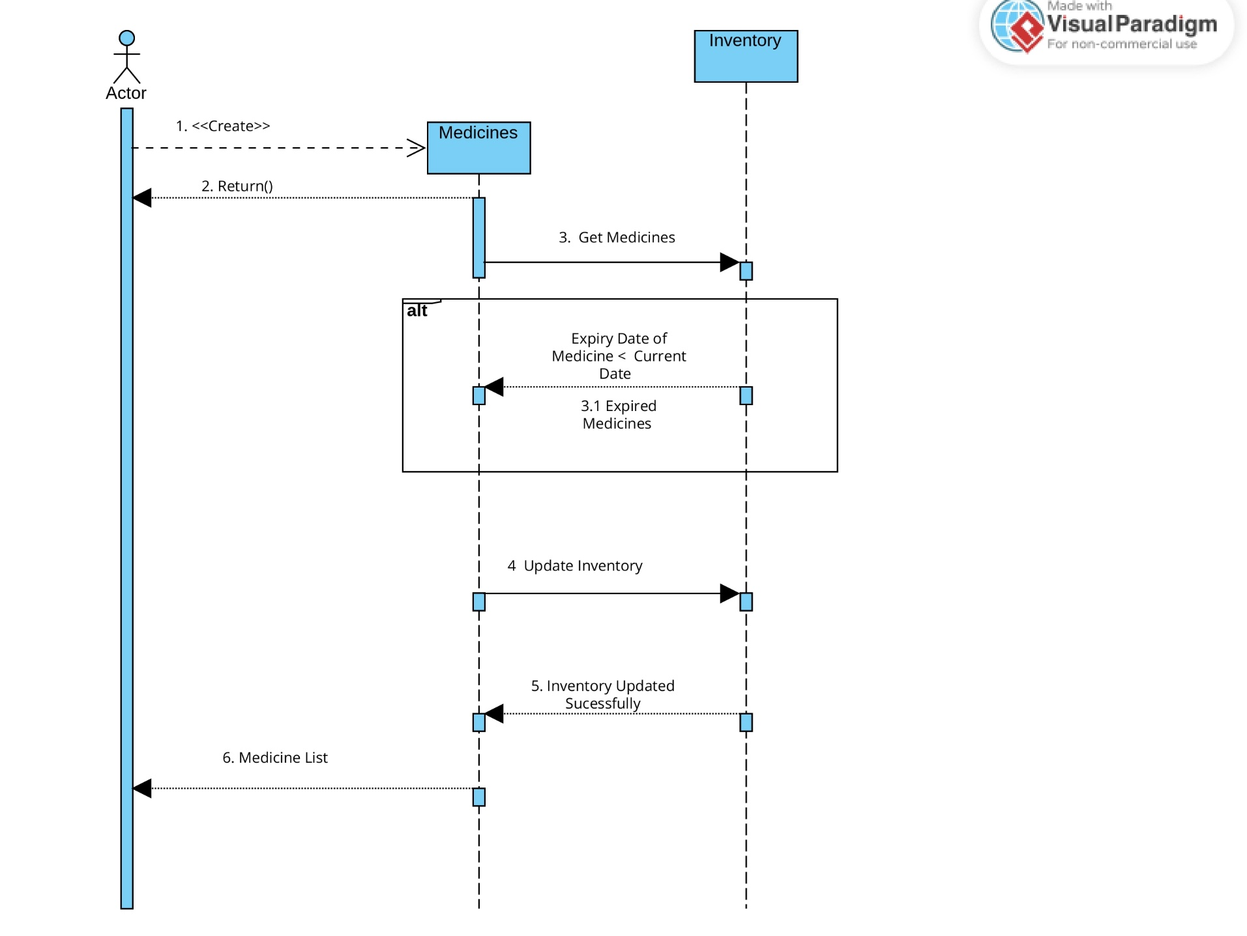
Sequence Diagram for Expired Medicine

Slide 17
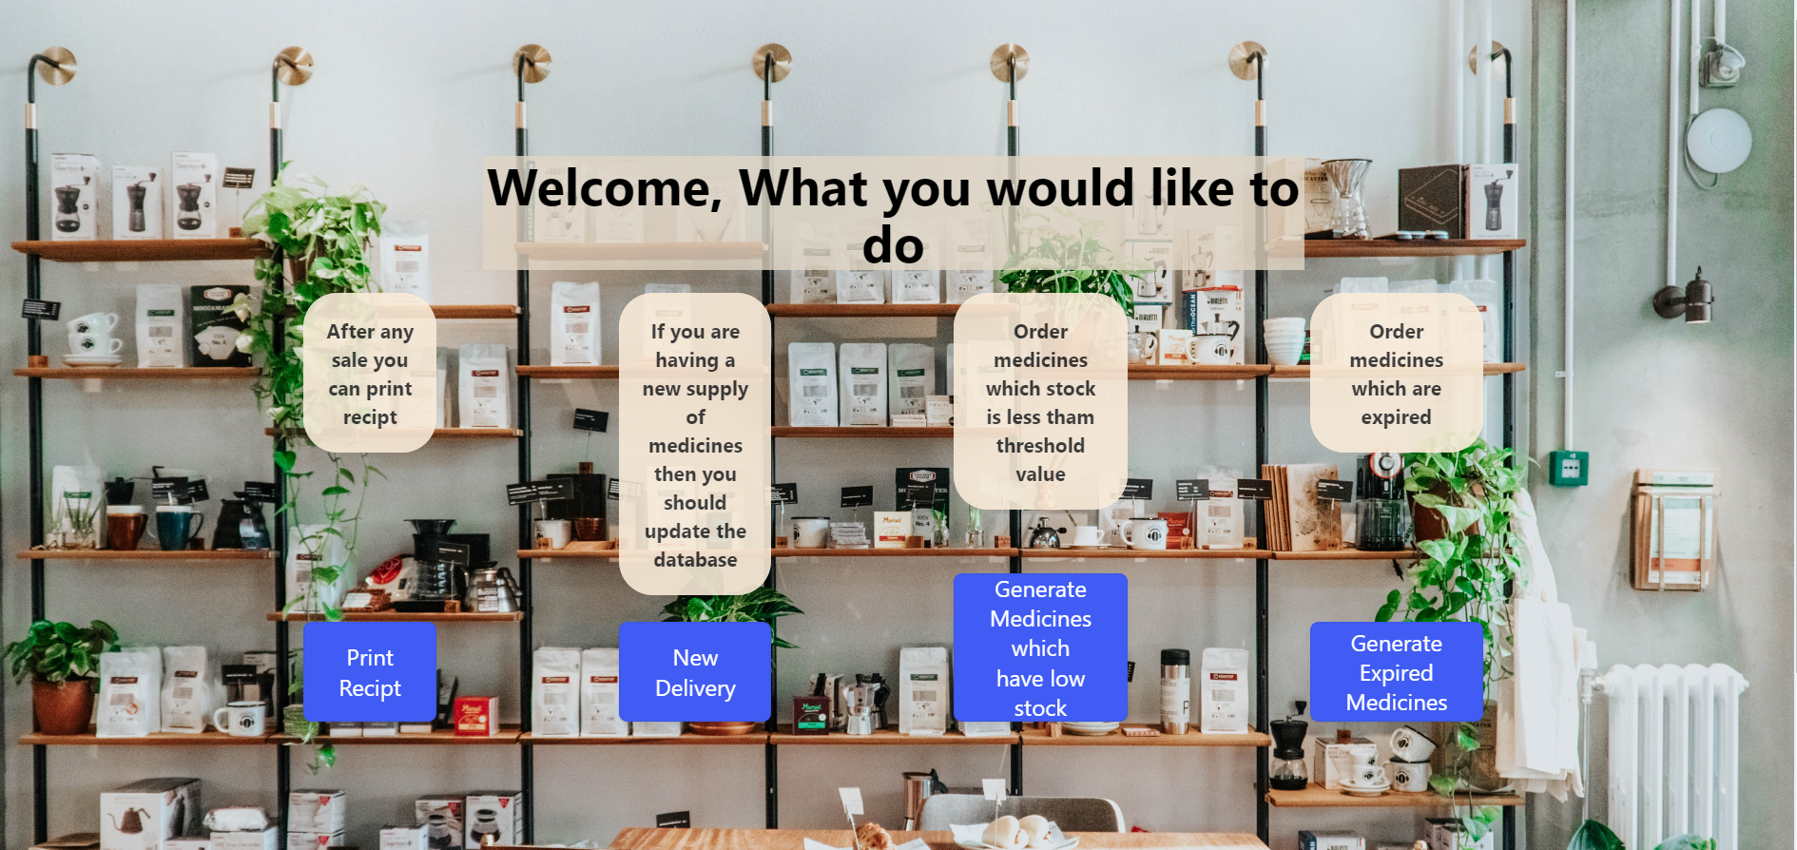
Home Page

Slide 18
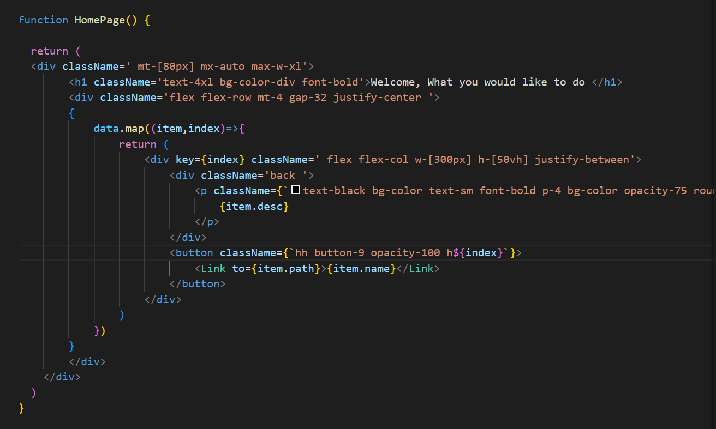
Code snippet for Home Page

Slide 19
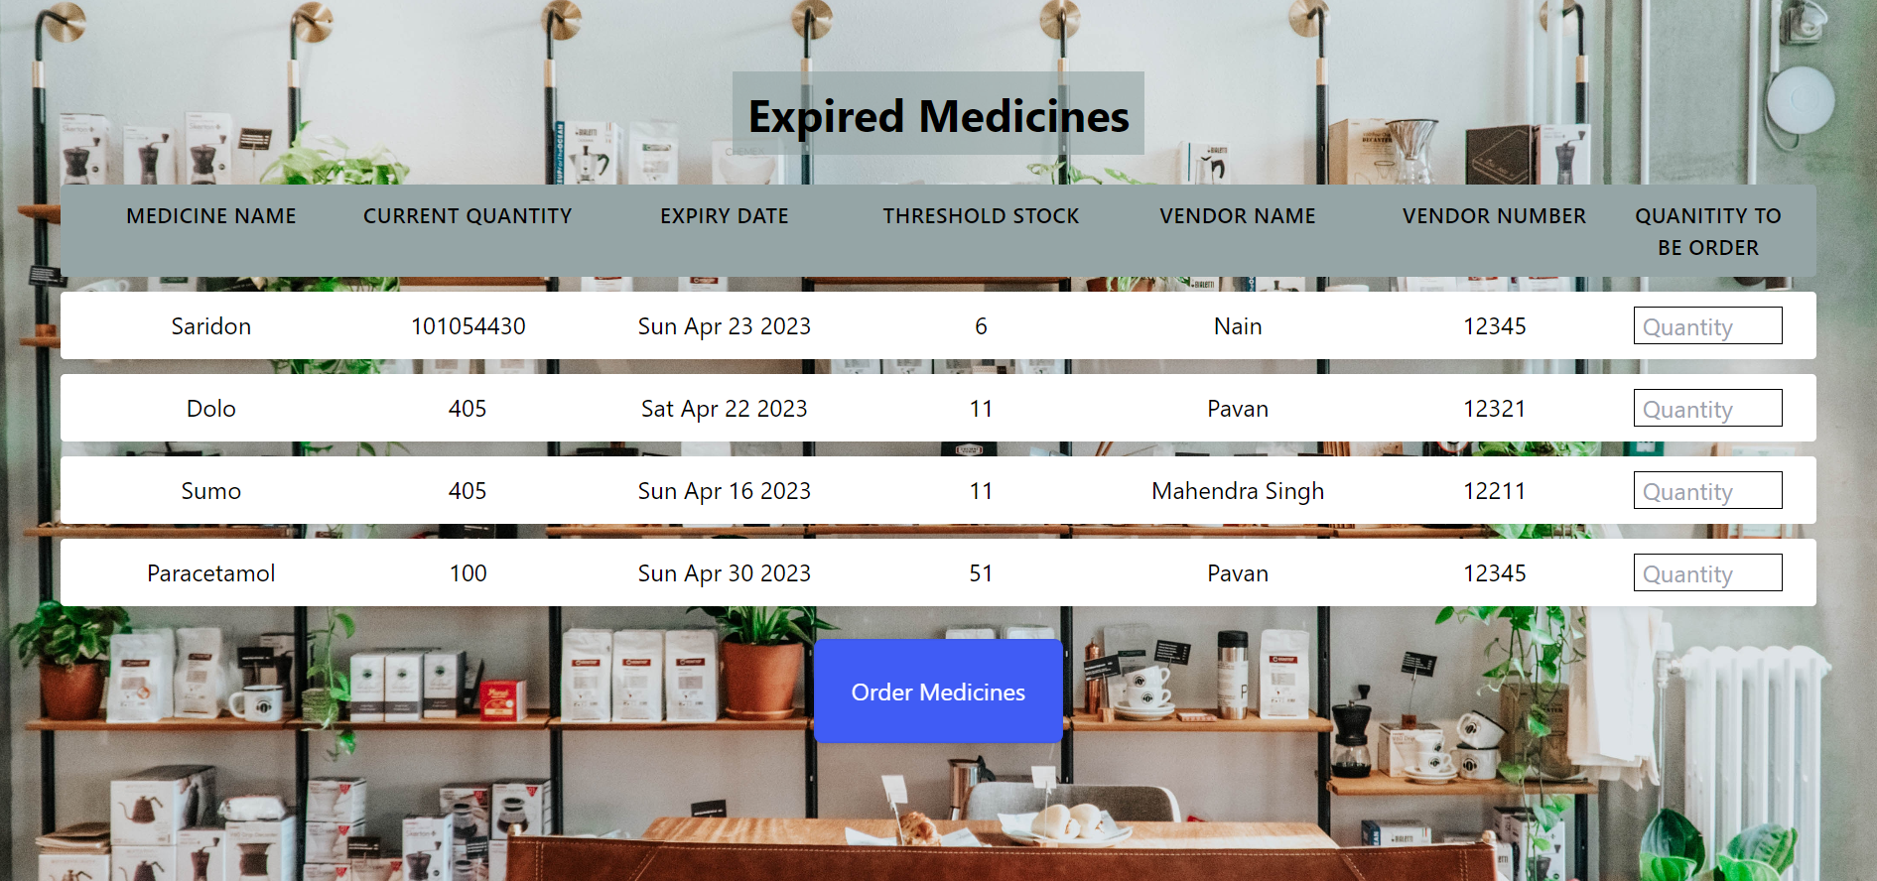
List of Expired Medicines

Slide 20
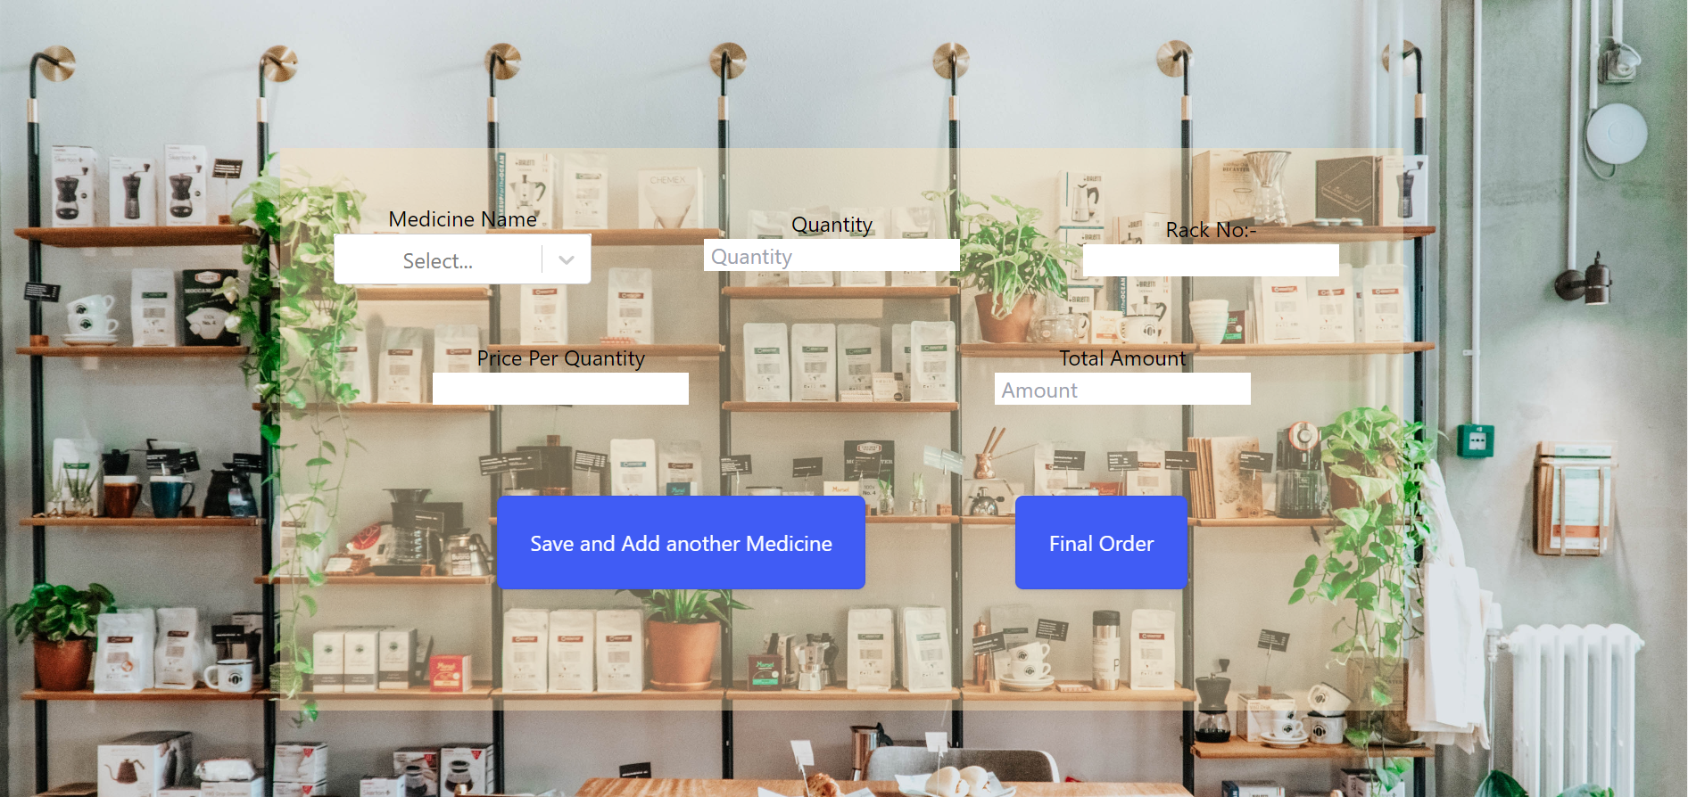
Search and Sale

Slide 21
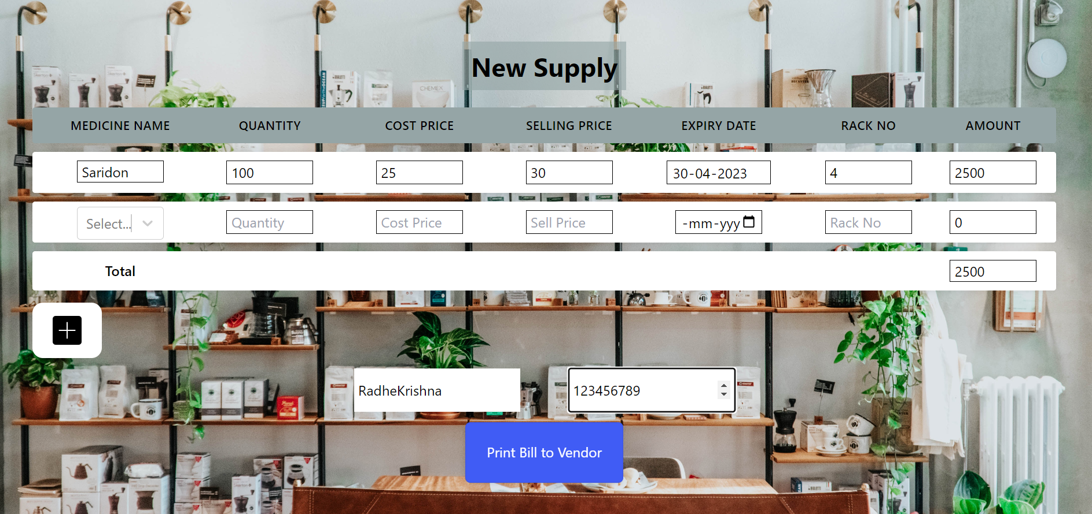
Updating Inventory

Slide 22
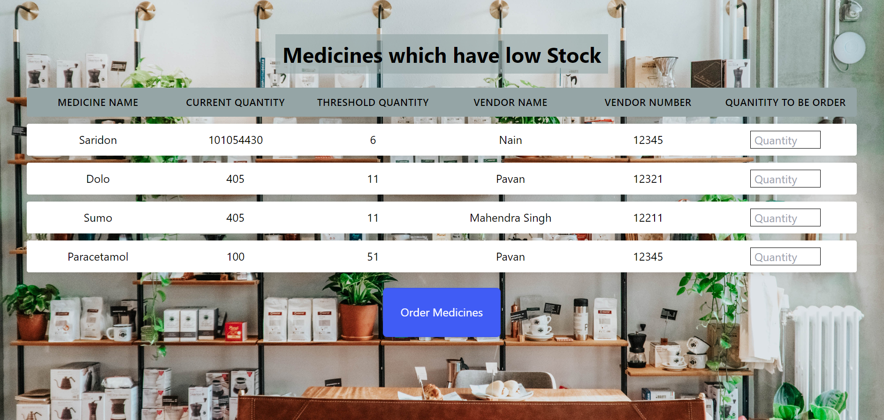
List of Low Stock Medicines

Slide 23
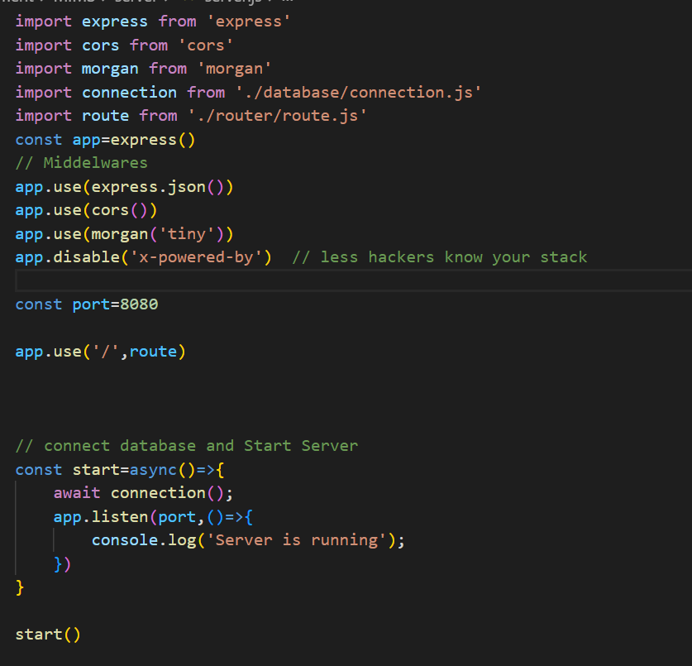
Code snippet for Server

Slide 24
Thank You

